Slide 1
Ethereum

Slide 2

What is Ethereum
Vitalik Buterin created a project in 2013, he wanted to design a scripting language to create programs for Bitcoin.
Bitcoin is a cryptocurrency, but Ethereum was not designed as a cryptocurrency, Ethereum was designed as a platform so that other programs can be created on top of it.

Slide 3
Since the internet allowed us to be interconnected, the idea here is:
To build a blockchain not only for storing the transactions between interconnected people,
But also to allow us to store programs and,
Facilitate the execution of these programs,
This way we make these programs decentralized.

Slide 4




Slide 5
Decentralized applications can be run on the computers of the participants of the blockchain network.
Instead of launching an application on a remote server and then anyone have to go to that server and communicate with it.
If we can run an application (Ex. Browser) on everybody's computer at the same time, then this will be an alternative way and the application will be completely decentralized.

Slide 6
The idea here is to build a world supercomputer in a distributed manner and use blockchain to facilitate the usage of that super computer.
This world supercomputer will not be in one location or on very strong computer, BUT it will consist of all of our PCs or laptops connected together and working to execute apps and programs and this way we will be able to perform many things in this environment.

Slide 7
All of that will be facilitated through Blockchain where the programs will be described, the transactions will be stored, any changes will be recorded, and they will be in an immutable state.
Also, a copy of that blockchain will exist on every single computer.

Slide 8
The idea of Ethereum is to create the world's most powerful supercomputer that will be able to decentralize any application since the infrastructure is already there.
Ethereum is an open source, globally decentralized computing infrastructure that executes programs called smart contracts. It uses a blockchain to synchronize and store the system’s state changes, along with a cryptocurrency called ether to meter and constrain execution resource costs.
source:“Mastering Ethereum by Andreas M. Antonopoulos and Dr. Gavin Wood (O’Reilly). Copyright 2019 The Ethereum Book LLC and Gavin Wood, 978-1-491-97194-9."

Slide 9



Slide 10
Compared to Bitcoin
Ethereum shares many common elements with other open blockchains:
a peer-to-peer network connecting participants,
a Byzantine fault–tolerant consensus algorithm for synchronization of state updates (a proof-of-work blockchain),
the use of cryptographic primitives such as digital signatures and hashes,
and a digital currency (ether).
“Mastering Ethereum by Andreas M. Antonopoulos and Dr. Gavin Wood (O’Reilly). Copyright 2019 The Ethereum Book LLC and Gavin Wood, 978-1-491-97194-9."

Slide 11
Ethereum is different from previous open blockchains including Bitcoin.
Ethereum’s purpose is not primarily to be a digital currency payment network: ether is intended as a utility currency to pay for use of the Ethereum platform as the world computer.
Unlike Bitcoin, which has a very limited scripting language, Ethereum is designed to be a general-purpose programmable blockchain that runs a virtual machine capable of executing code of arbitrary and unbounded complexity.
Bitcoin’s Script language is, intentionally, constrained to simple true/false evaluation of spending conditions, Ethereum’s language is Turing complete, meaning that Ethereum can straightforwardly function as a general-purpose computer.
“Mastering Ethereum by Andreas M. Antonopoulos and Dr. Gavin Wood (O’Reilly). Copyright 2019 The Ethereum Book LLC and Gavin Wood, 978-1-491-97194-9."

Slide 12
Components of a Blockchain
A peer-to-peer (P2P) network connecting participants and propagating transactions and blocks of verified transactions, based on a standardized protocol.
Messages, in the form of transactions, representing state transitions
A set of consensus rules, governing what constitutes a transaction and what makes for a valid state transition
A state machine that processes transactions according to the consensus rules
A chain of cryptographically secured blocks that acts as a journal of all the verified and accepted state transitions
A consensus algorithm that decentralizes control over the blockchain, by forcing participants to cooperate in the enforcement of the consensus rules
A game-theoretically sound incentivization scheme (e.g., proof-of-work costs plus block rewards) to economically secure the state machine in an open environment
One or more open source software implementations of the above ("clients")
“Mastering Ethereum by Andreas M. Antonopoulos and Dr. Gavin Wood (O’Reilly). Copyright 2019 The Ethereum Book LLC and Gavin Wood, 978-1-491-97194-9."

Slide 13
The original blockchain: Bitcoin’s blockchain,
tracks the state of units of bitcoin and their ownership.
a distributed consensus state machine, where transactions cause a global state transition, altering the ownership of coins. The state transitions are constrained by the rules of consensus,
allowing all participants to (eventually) converge on a common (consensus) state of the system, after several blocks are mined.
“Mastering Ethereum by Andreas M. Antonopoulos and Dr. Gavin Wood (O’Reilly). Copyright 2019 The Ethereum Book LLC and Gavin Wood, 978-1-491-97194-9."

Slide 14
On July 30, 2015, the first Ethereum block was mined.
Ethereum is also a distributed state machine.
Ethereum tracks the state transitions of a general-purpose data store, i.e., a store that can hold any data expressible as a key–value tuple. A key–value data store holds arbitrary values, each referenced by some key; for example, the value "Mastering Ethereum" referenced by the key "Book Title".
Ethereum has memory that stores both code and data, and it uses the Ethereum blockchain to track how this memory changes over time.
Ethereum can load code into its state machine and run that code, storing the resulting state changes in its blockchain.
Ethereum state changes are governed by the rules of consensus and the state is distributed globally.
Ethereum track any arbitrary state and program the state machine to create a world-wide computer operating under consensus
“Mastering Ethereum by Andreas M. Antonopoulos and Dr. Gavin Wood (O’Reilly). Copyright 2019 The Ethereum Book LLC and Gavin Wood, 978-1-491-97194-9."

Slide 15
Ethereum’s Components
P2P network: Ethereum runs on the Ethereum main network, which is addressable on TCP port 30303, and runs a protocol called DEVp2p.
Consensus rules: Ethereum’s consensus rules are defined in the reference specification, the Yellow paper
Transactions: Ethereum transactions are network messages that include (among other things) a sender, recipient, value, and data payload.
State machine: Ethereum state transitions are processed by the Ethereum Virtual Machine (EVM), a stack-based virtual machine that executes bytecode (machine-language instructions). EVM programs, called "smart contracts," are written in high-level languages (e.g., Solidity) and compiled to bytecode for execution on the EVM.
“Mastering Ethereum by Andreas M. Antonopoulos and Dr. Gavin Wood (O’Reilly). Copyright 2019 The Ethereum Book LLC and Gavin Wood, 978-1-491-97194-9."

Slide 16
Data structures: Ethereum’s state is stored locally on each node as a database (usually Google’s LevelDB), which contains the transactions and system state in a serialized hashed data structure called a Merkle Patricia Tree.
Consensus algorithm: Ethereum uses Bitcoin’s consensus model, Nakamoto Consensus, which uses sequential single signature blocks, weighted in importance by PoW to determine the longest chain and therefore the current state. However, there are plans to move to a PoS weighted voting system, codenamed Casper, in the near future.
Economic security: Ethereum currently uses a PoW algorithm called Ethash, but this will eventually be dropped with the move to PoS at some point in the future.
Clients: Ethereum has several interoperable implementations of the client software, the most prominent of which are Go-Ethereum (Geth) and Parity.
“Mastering Ethereum by Andreas M. Antonopoulos and Dr. Gavin Wood (O’Reilly). Copyright 2019 The Ethereum Book LLC and Gavin Wood, 978-1-491-97194-9."

Slide 17
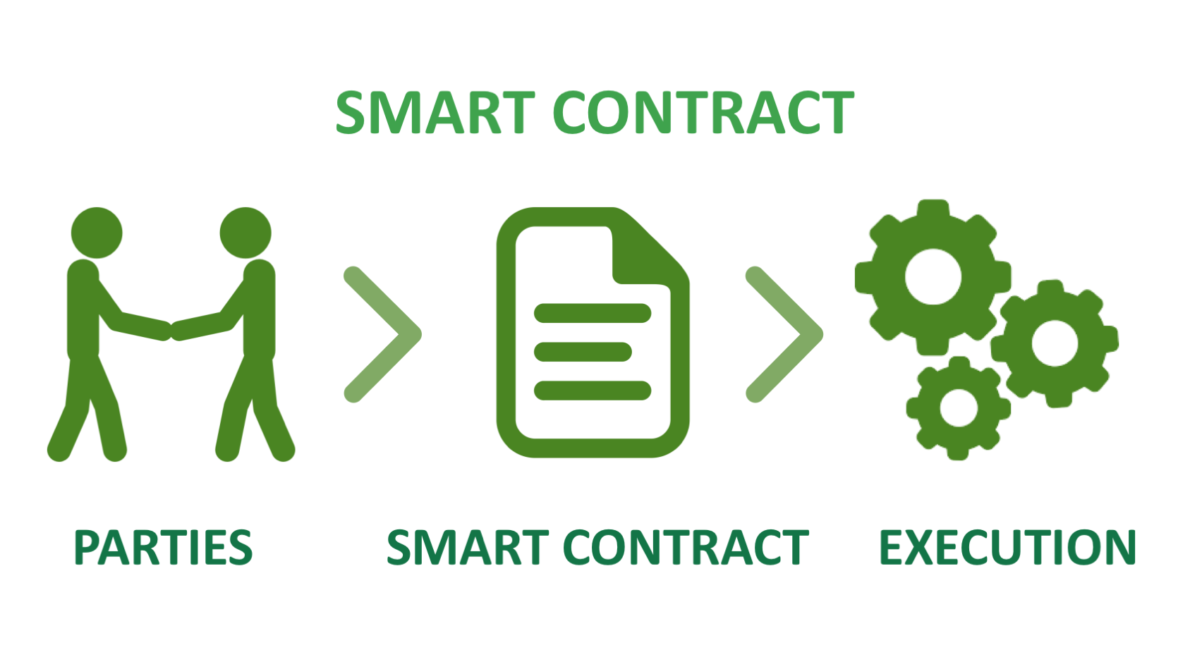
What is a smart contract
A contract is a set of rules that parties agree on and it governs the relationship between them.
Smart contracts are self-executing contracts (programs) which are run on the blockchain.
Smart contracts could be converted to computer code, stored and replicated on the system and supervised by the network of computers that run the blockchain.

Slide 18
Smart contracts can perform different tasks such as exchanging anything of value in a transparent, conflict-free way while avoiding the services of a third party.
Smart contracts define the rules and penalties of an agreement and automatically enforce any obligations.
Vitalik Buterin, explained the smart contract approach:
“an asset or currency is transferred into a program and the program runs this code and at some point it automatically validates a condition and it automatically determines whether the asset should go to one person or back to the other person, or whether it should be immediately refunded to the person who sent it or some combination thereof.”
The blockchain stores and replicates the document which insures security and immutability.

Slide 19
A smart contract is:
Executable code
Turing Complete (you can write programs (contracts) that can solve any reasonable computational problem. Having the ability to perform looping and branching statements as well as local state storage. Turing completeness is important for Ethereum smart contracts because you have the ability to implement sophisticated logic.)
Function like an external account
Hold funds
Can interact with other accounts and smart contracts
Contain code
Can be called through transactions

Slide 20
Every node contains a virtual machine (similar to Java)
Called the Ethereum Virtual Machine (EVM)
Compiles code from high-level language to bytecode
Executes smart contract code and broadcasts state
Every node on the blockchain processes every transaction and stores the entire state

Slide 21
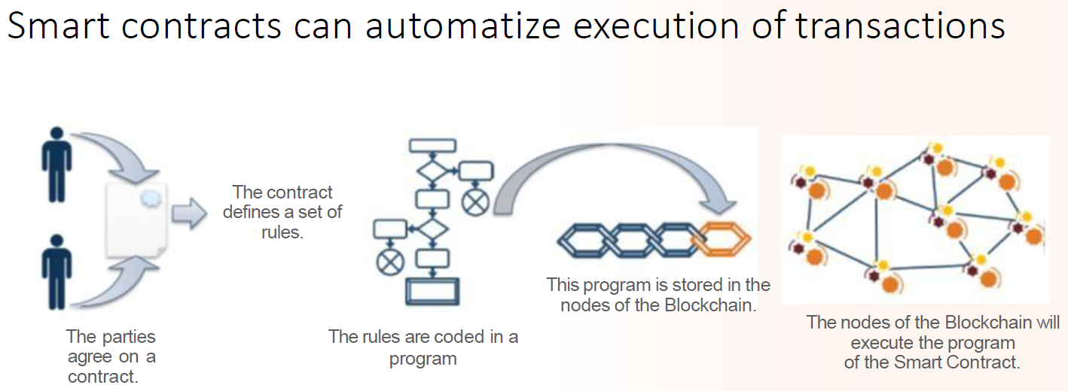
Source:John-Karamitsos-Blockchain-Smart-Contracts-Building-blocks-for-Smart-Cities
Smart contracts are useful in many occasions to replace human intervention (ex: in case of an a estate agency, to send automatically the keys once the contract has been signed, and rental has been paid).

Slide 22
Use Case: Smart Switch Contract IoT Source:John-Karamitsos-Blockchain-Smart-Contracts-Building-blocks-for-Smart-Cities
Users can turn a switch “on” or “off” for a certain duration by sending a transaction with a Value to the smart contract associated with the switch.
The contract act as an agreement between the user and the switch to turn on the switch on for a certain duration based on the amount of cryptocurrency (Ether) sent by the user to the Smart Switch contract account.
Such case can be used for automating solar charging stations.
For example, where a user can connect their devices to a charging station and then send a transaction to the smart contract associated with the charging station to activate it.

Slide 23


Smart contracts are code that can be recorded on the blockchain.
In Bitcoin there is a programming language called Bitcoin's script and it allows us to code things on the blockchain.
In Ethereum there is a programming language called solidity and it allows us to code things on the blockchain.
Bitcoin script is not Turing complete and solidity is Turing complete.
Turing completeness means that you can code absolutely any logic into that language.

Slide 24
Alan Turing created a machine that can take a program and run that program and show some result. But then he had to create different machines for different programs. So he created "Universal Turing Machine" that can take ANY program and run it.
Programming languages are similar to those machines (although virtual). They take programs and run them. A programing language is called "Turing complete", if it can run any program that a Turing machine can run given enough time and memory.

Slide 25
Why is Bitcoin's script not Turing complete?
Because there is a very important component that is missing, and that component is called loops.
Bitcoin scripts does not have loops intentionally, since the programs are running on every single node in the chain; they can slow down the blockchain.

Slide 26
If someone intentionally or unintentionally creates a program that has an infinite loop then It can destroy the whole blockchain or it can hide the whole blocks and slow everything down.
Even if a finite loop but long enough it can have a dangerous effect.
To avoid any kind of potential problems with programs running for long time or going into infinite loops Bitcoin scripts decided not to include loops.

Slide 27
In blockchain, a new block is added to the chain, so beside recording transactional data and other data, now a smart contract is being recorded too.
Everyone in the network will have a copy of the smart contract.
A computer program (a smart contract) is copied into your machine which will run there and everyone has a copy of it.

Slide 29
Each node has the history of all previous smart contracts.
When the nodes update their blockchain copy, all previous and new blocks are copied on every machine including any previous smart contracts.
Each node has a history of all previous transactions.
Each node has the current state of all smart contracts.

Slide 30
The smart contracts are programs that execute, once a smart contract executes it change to a new state, if they execute then the result could trigger another execution which in turn lead to a new state and so on.
Every node will know what is the current state of each smart contract in the blockchain.

Slide 31
Ethereum Virtual Machine
Two major security threats about blockchain:
Loops:
someone could intentionally or by accident use an infinite loop or a very long loop that could slow down the network of the blockchain, this may prevent the network users from using it or make it take a very long time to utilize the network. Bitcoin didn’t include loops in its code, but Ethereum did.
Unauthorized access to private files and a virus written as a smart contract:
since the smart contracts are applications that run over the network nodes, it could be the ideal way to infect the nodes with a virus and distribute allover the network.

Slide 32
When a user joins the Ethereum network, a virtual machine will be installed on his\her machine (EVM).
This virtual machine will run all the applications that belongs to the Ethereum network.
The EVM isolates the Ethereum apps from other applications that belongs to the user real machine (host).
The smart contract runs inside the EVM and it does not know anything that is outside the EVM.

Slide 33
The smart contract will be running inside the EVM, which means it only know about the EVM environment but do not know about the host machine.
Smart contracts don’t have access to the personal files that are stored in the host machine environment.
BY using the EVM, the security and privacy of the Ethereum users is guaranteed, since whatever is being executed by a smart contract it does not have access to any data stored in the host machine, hence, no security threats resulted from using smart contracts.

Slide 34
GAS and Infinite or very long loops
Gas refers to the pricing value required to successfully conduct a transaction or execute a contract on the Ethereum blockchain platform.
Gas indicates the consumption of the computational expenses on the Ethereum network.
The gas represents the price (computational power) to process a smart contract or transaction on Ethereum at that particular time.

Slide 35
Ethereum miners, perform all the important tasks of verifying and processing a transaction, they are awarded some fees for consuming their computational power services.
If the gas price limit is too low, miners can choose to ignore such transactions.

Slide 36
The gas principle solves the problem of programs that contain infinite loops, or any computationally heavy program, such kind of programs will run out of gas so fast, and eventually it will stop working.
Any one who writes this kind of heavy programs will be penalized, also there will be no problem in the Ethereum network since these programs will be stopped quickly.

Slide 37
This motivates the users to write optimized code so that it will not cost a lot of gas, and by doing so the performance of the whole network will be efficient.
https://github.com/djrtwo/evm-opcode-gas-costs/blob/master/opcode-gas-costs_EIP-150_revision-1e18248_2017-04-12.csv
https://ethgasstation.info/

Slide 38
How to get gas to pay for computation on the Ethereum world computer?
You won’t find gas on any exchanges.
It can only be purchased as part of a transaction, and can only be bought with ether.
Ether needs to be sent along with a transaction and it needs to be explicitly earmarked for the purchase of gas, along with an acceptable gas price.
The price of gas is not fixed.
Any unused gas is refunded back to the sender of the transaction.
“Mastering Ethereum by Andreas M. Antonopoulos and Dr. Gavin Wood (O’Reilly). Copyright 2019 The Ethereum Book LLC and Gavin Wood, 978-1-491-97194-9."

Slide 39
Ether Currency Units
Ethereum’s currency unit is called ether, identified also as "ETH“.
Ether is subdivided into smaller units, down to the smallest unit possible, which is named wei. One ether is 1 quintillion wei (1 * 10 or 1,000,000,000,000,000,000).
Ethereum is the system, ether is the currency.
“Mastering Ethereum by Andreas M. Antonopoulos and Dr. Gavin Wood (O’Reilly). Copyright 2019 The Ethereum Book LLC and Gavin Wood, 978-1-491-97194-9."

Slide 40
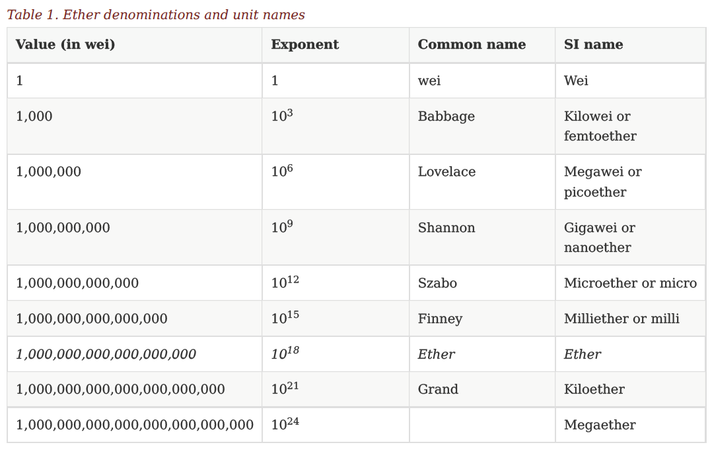
“Mastering Ethereum by Andreas M. Antonopoulos and Dr. Gavin Wood (O’Reilly). Copyright 2019 The Ethereum Book LLC and Gavin Wood, 978-1-491-97194-9."

Slide 41
As we know in Ethereum network, the cryptocurrency is ether, so why they need gas to represent the computational cost?
The price of ether oscillate extremely most of the time, it goes up and down frequently.
So if these prices were in ether then it will not reflect the real cost for the required computational power,
And if these prices went down sharply, then programs that contain heavy code will consume the computation power and make the ethereum network very slow.

Slide 42
The core principle idea behind bitcoin is to create a cryptocurrency that allows people to transact and pay for services without restrictions and without intermediaries, and without asking for permission.
Although people can use ether to transact and invest, it was not designed to be a cryptocurrency, but the core principle behind it is to create a system and network where people can run their code (applications ) on the blockchain and pay for that using ether.

Slide 43
Ethereum target is to create an environment where programs can be safely run on the blockchain, where all of these applications will be decentralized so that there will be no need for central organizations that have the central servers.

Slide 44
Decentralized Applications (Dapps)
Dapps use smart contracts to interact with the blockchain and they allow users to interact with the application itself.
Dapp is an interface that enables the users to interact with applications. It consists of a front end and a back end (the smart contract).
The smart contracts acts as and API (Application Programming Interface) which allows the application to work on and interact with the blockchain, and allows the users to interact with the application.

Slide 45


Dapp

Slide 46
Dapps Advantages:
No central point of failure
Immutable
Secure
Open source
Examples:
Golem:https://golem.network/
Augur: https://www.augur.net/
Melonport:https://melonport.com/

Slide 47
Decentralized Applications (DApps)
Ethereum’s expanded to become a platform for programming DApps.
A DApp is, at the very least, a smart contract and a web user interface. More broadly, a DApp is a web application that is built on top of open, decentralized, peer-to-peer infrastructure services.
A DApp is composed of at least:
Smart contracts on a blockchain
A web frontend user interface
In addition, many DApps include other decentralized components, such as:
A decentralized (P2P) storage protocol and platform
A decentralized (P2P) messaging protocol and platform
“Mastering Ethereum by Andreas M. Antonopoulos and Dr. Gavin Wood (O’Reilly). Copyright 2019 The Ethereum Book LLC and Gavin Wood, 978-1-491-97194-9."

Slide 48
Web3
In 2004 the term "Web 2.0" came to prominence, describing an evolution of the web toward user generated content, responsive interfaces, and interactivity.
The concept of DApps is meant to take the World Wide Web to its next natural evolutionary stage, introducing decentralization with peer-to-peer protocols into every aspect of a web application.
The term used to describe this evolution is web3, meaning the third "version" of the web.
Web3 represents a new vision and focus for web applications: from centrally owned and managed applications, to applications built on decentralized protocols.
“Mastering Ethereum by Andreas M. Antonopoulos and Dr. Gavin Wood (O’Reilly). Copyright 2019 The Ethereum Book LLC and Gavin Wood, 978-1-491-97194-9."

Slide 49
Ethereum web3.js JavaScript library, bridges JavaScript applications that run in the browser with the Ethereum blockchain.
The web3.js library also includes an interface to a P2P storage network called Swarm and a P2P messaging service called Whisper.
With these three components included in a JavaScript library running in your web browser, developers have a full application development suite that allows them to build web3 DApps.
“Mastering Ethereum by Andreas M. Antonopoulos and Dr. Gavin Wood (O’Reilly). Copyright 2019 The Ethereum Book LLC and Gavin Wood, 978-1-491-97194-9."

